Slide 1
From data to knowledge
Juan Galeano
Harbour Space, Campus Bangkok, January 2024

Slide 2
DAILY SINS OF (ACADEMIC) DATA VISUALIZATION
Data dump
Lack of comparability
3D trap
Poor labeling
Lack of context
Barplots start at zero (but lines do not, necessarily).
Declutter
Be aware with pie charts
Flip your axis

Slide 3
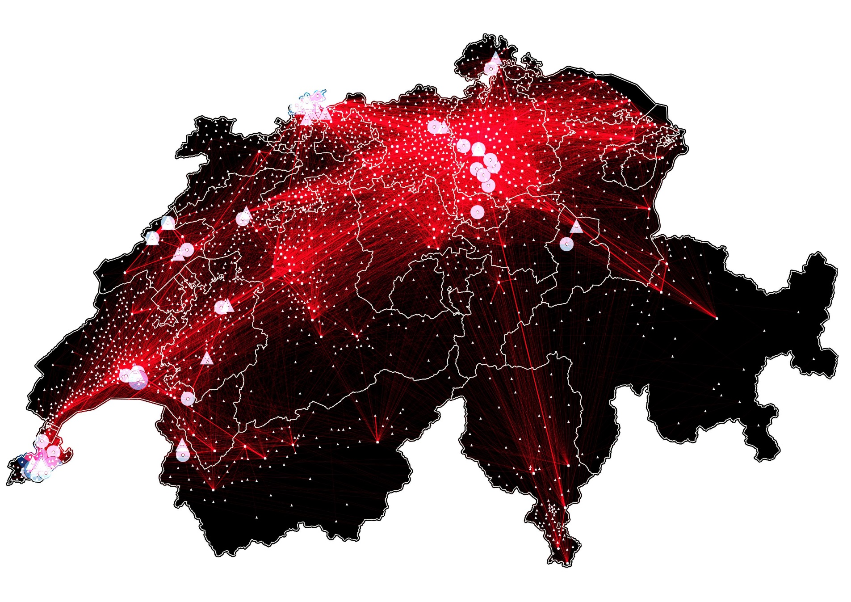
Daily sins of (academic) data visualization: DATA DUMP
Internal migration of foreign nationals, selected municipalities, Switzerland 2017

Slide 4
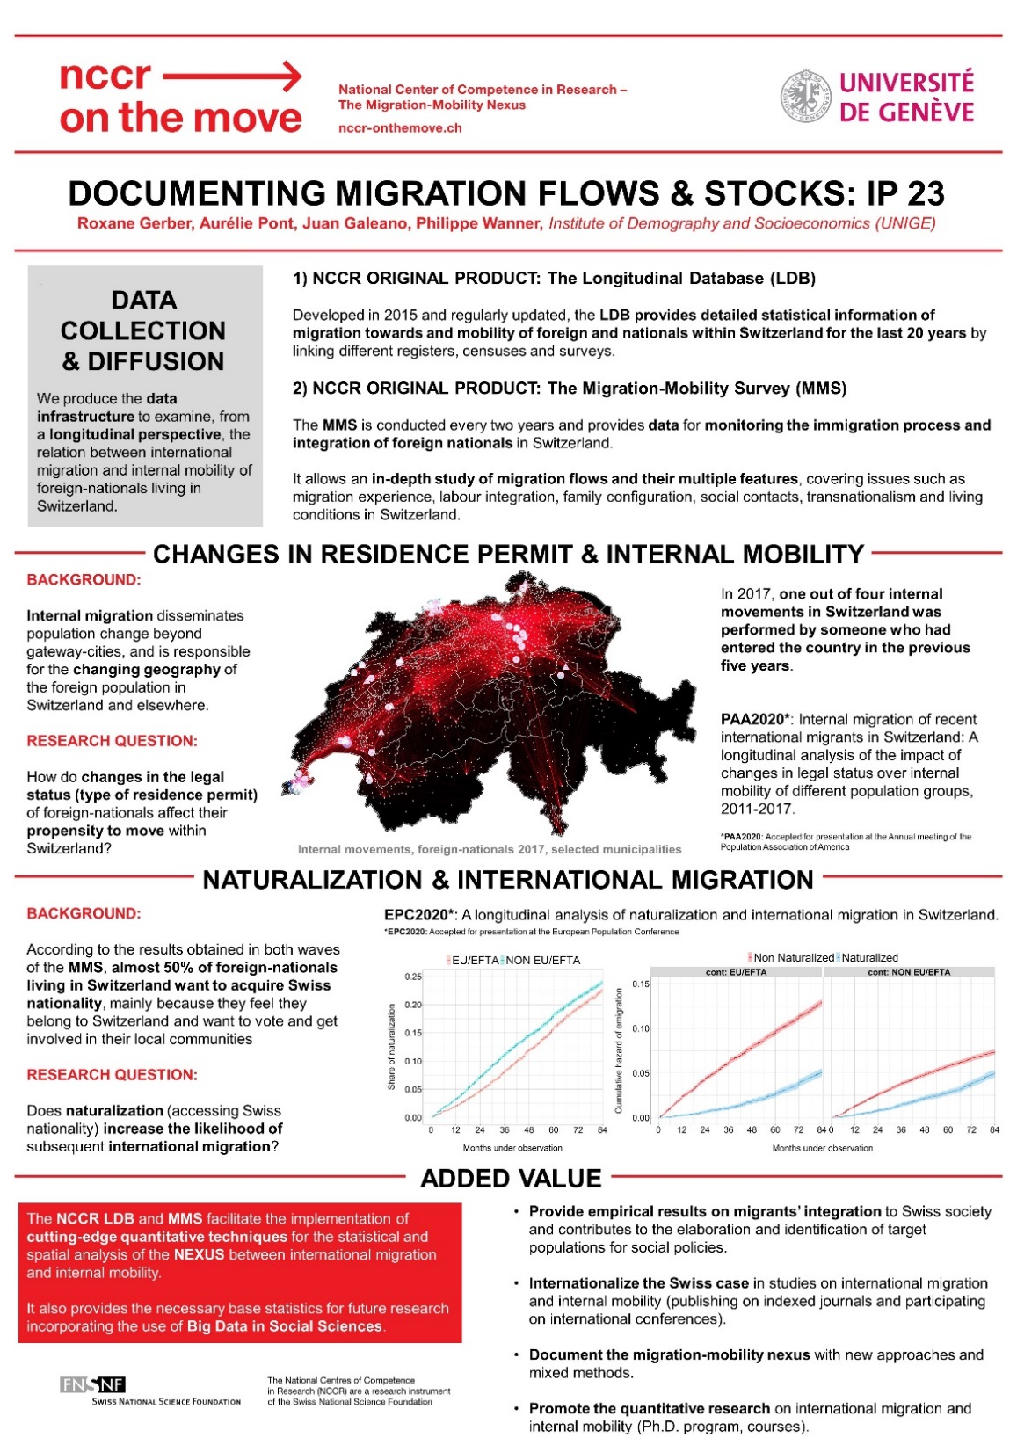

Slide 5
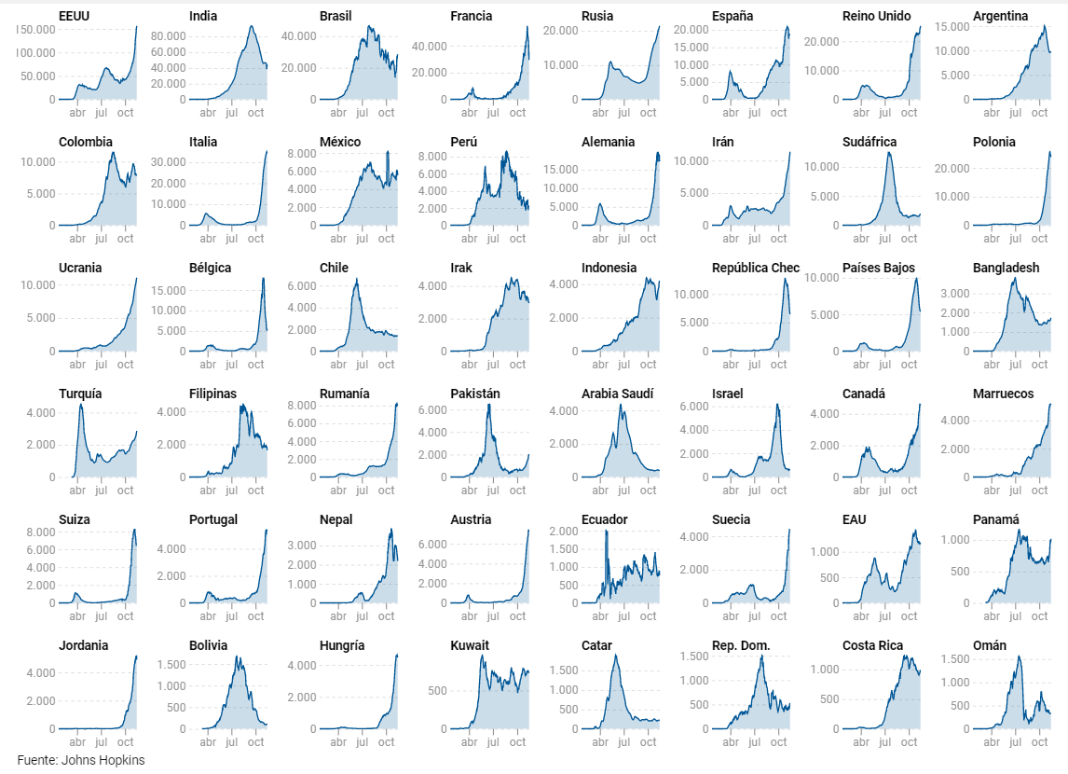
Daily sins of (academic) data visualization: LACK OF COMPARABILITY
7 days moving average of COVID-19 cases by country: Published in the Spanish newspaper eldiario.es

Slide 6
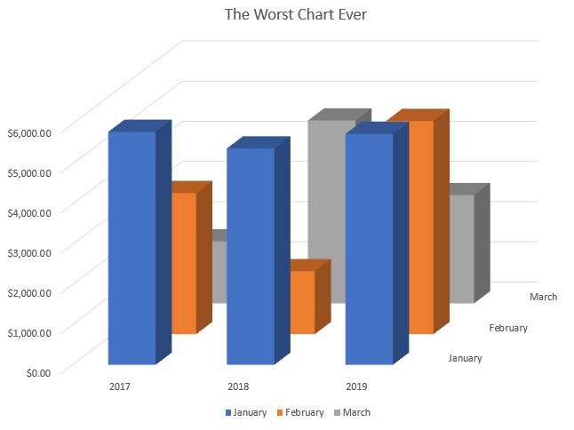
Daily sins of (academic) data visualization: THE 3D TRAP

Slide 7
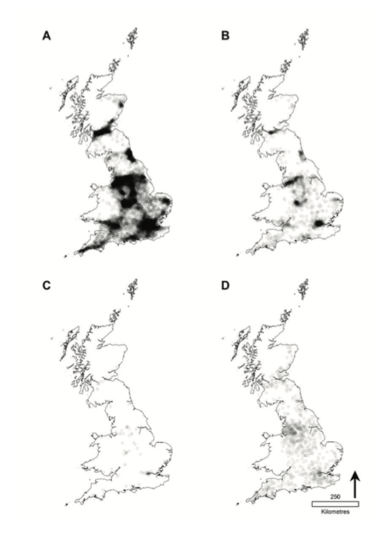
Daily sins of (academic) data visualization: POOR LABELING
Even the most basic scatter plot benefits from a label or two to highlight the most interesting data points.
Well labelled plots make it much easier to explain the graphic in the caption or main text.

Slide 8
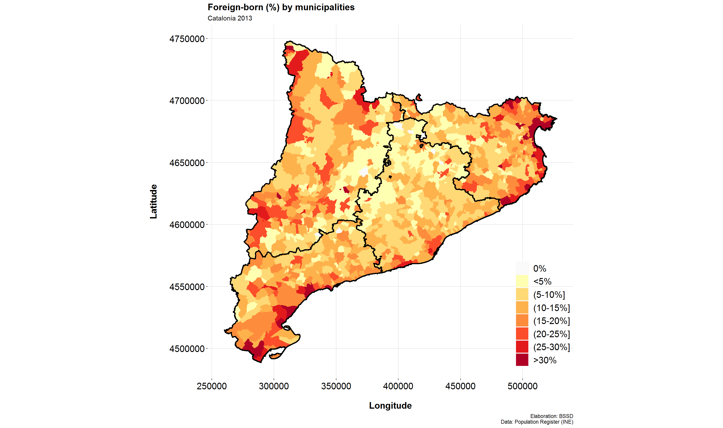
Daily sins of (academic) data visualization: LACK OF CONTEXT

Slide 9
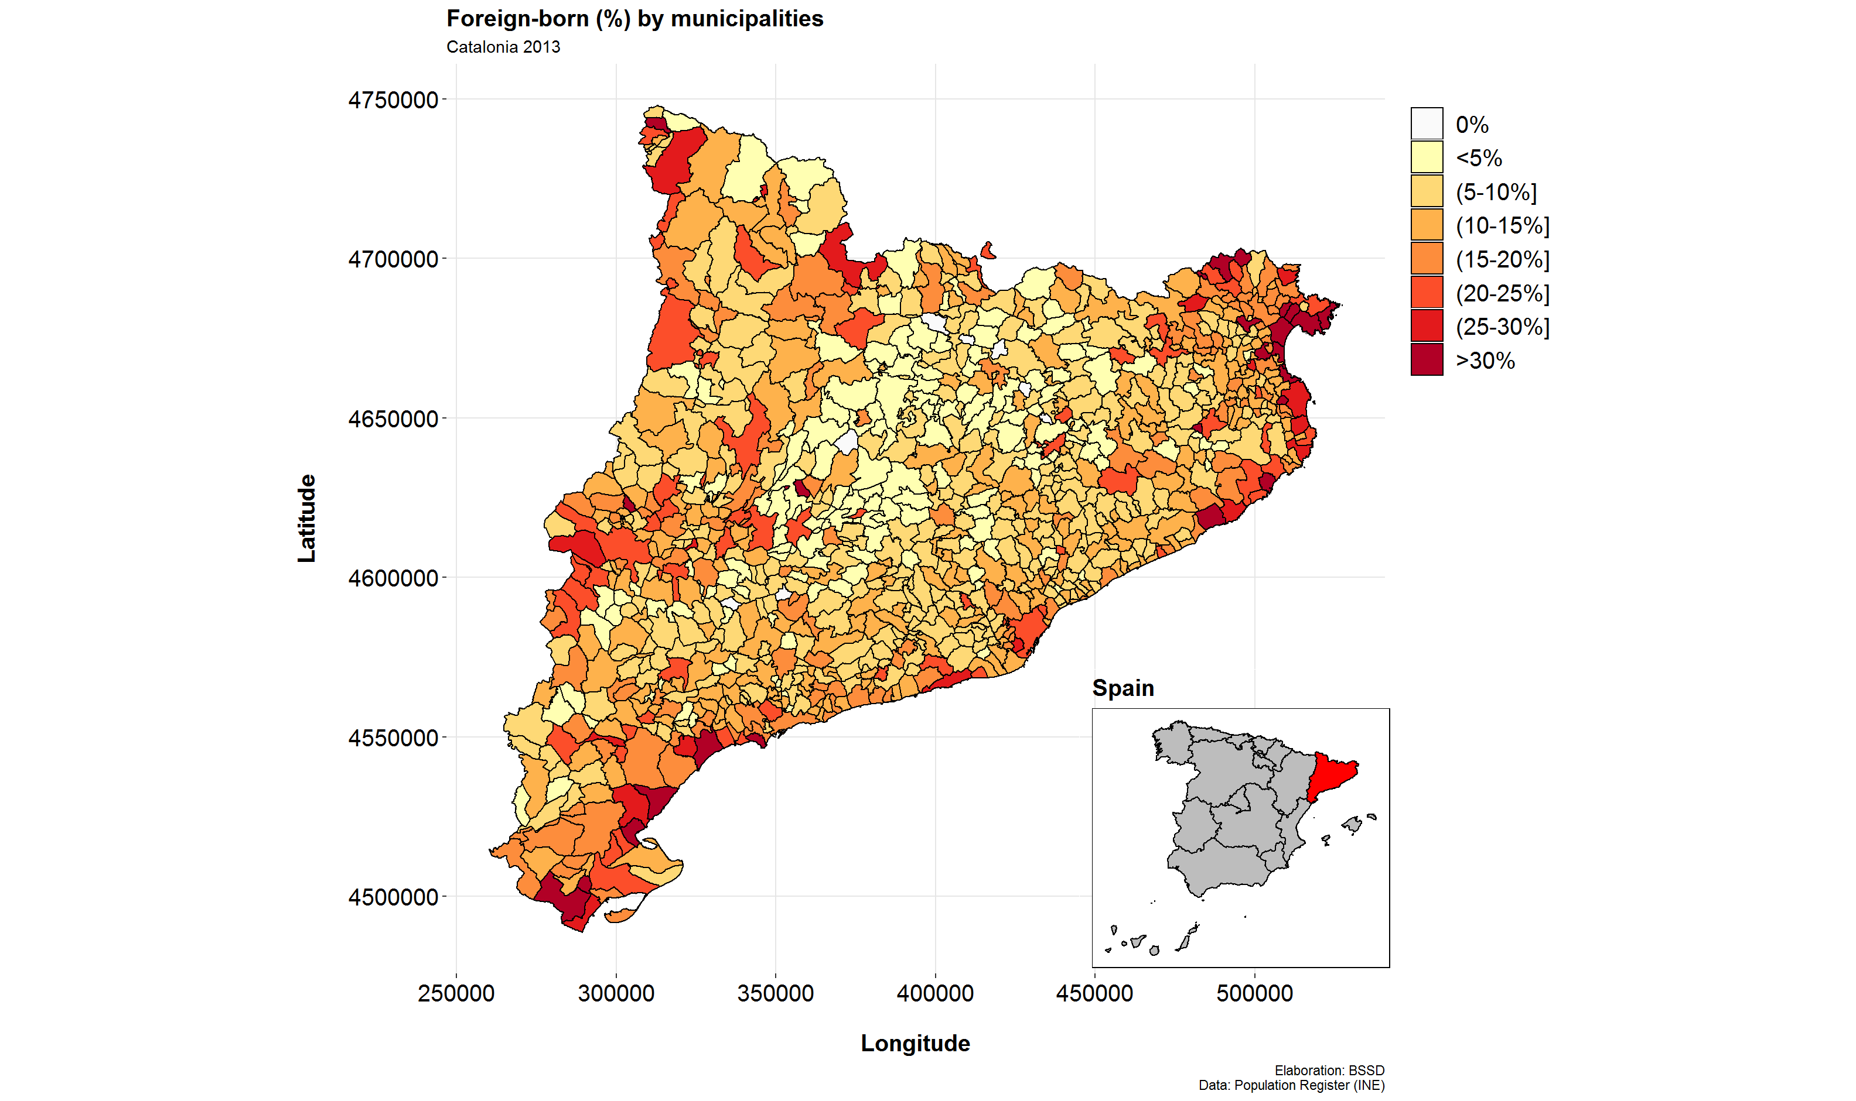
Daily sins of (academic) data visualization: LACK OF CONTEXT

Slide 10
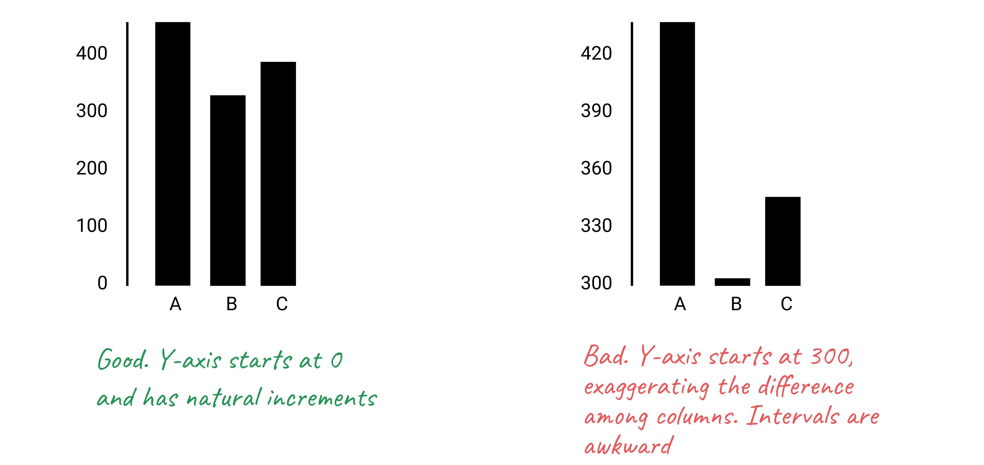
Daily sins of (academic) data visualization: Start your barplots at 0
Source: “Hands-On Data Visualization” by Jack Dougherty & Ilya Ilyankou

Slide 11
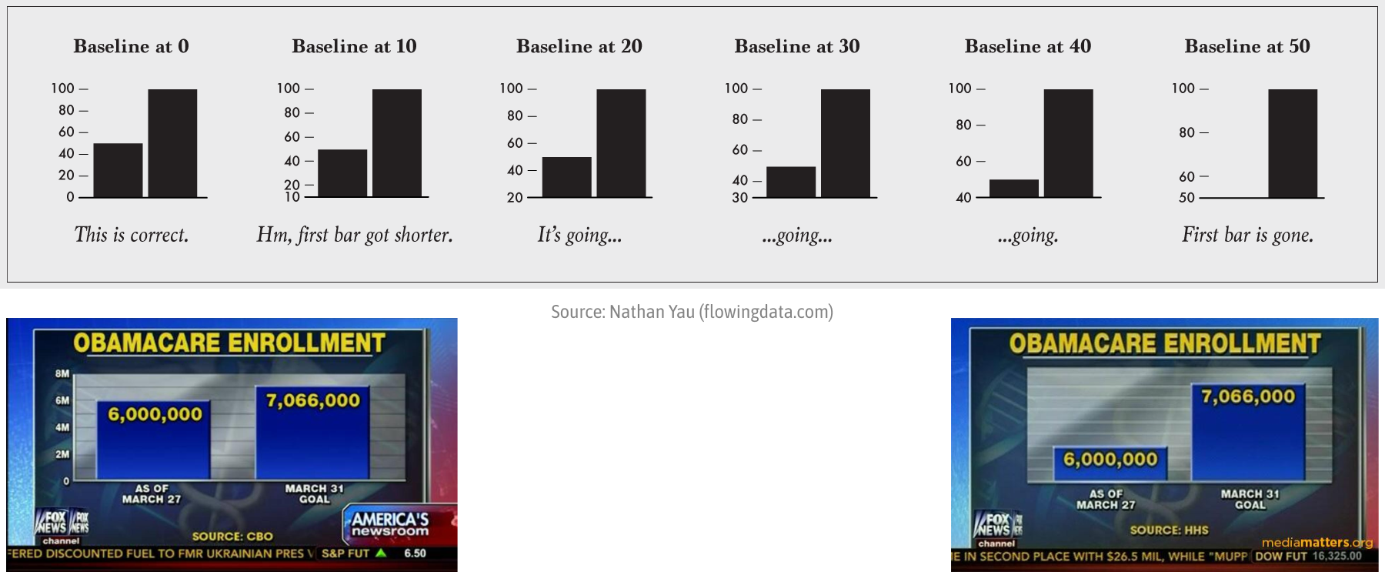
Daily sins of (academic) data visualization: Start your barplots at 0
Source: Cédric Scherer // posit::conf(2023)

Slide 12
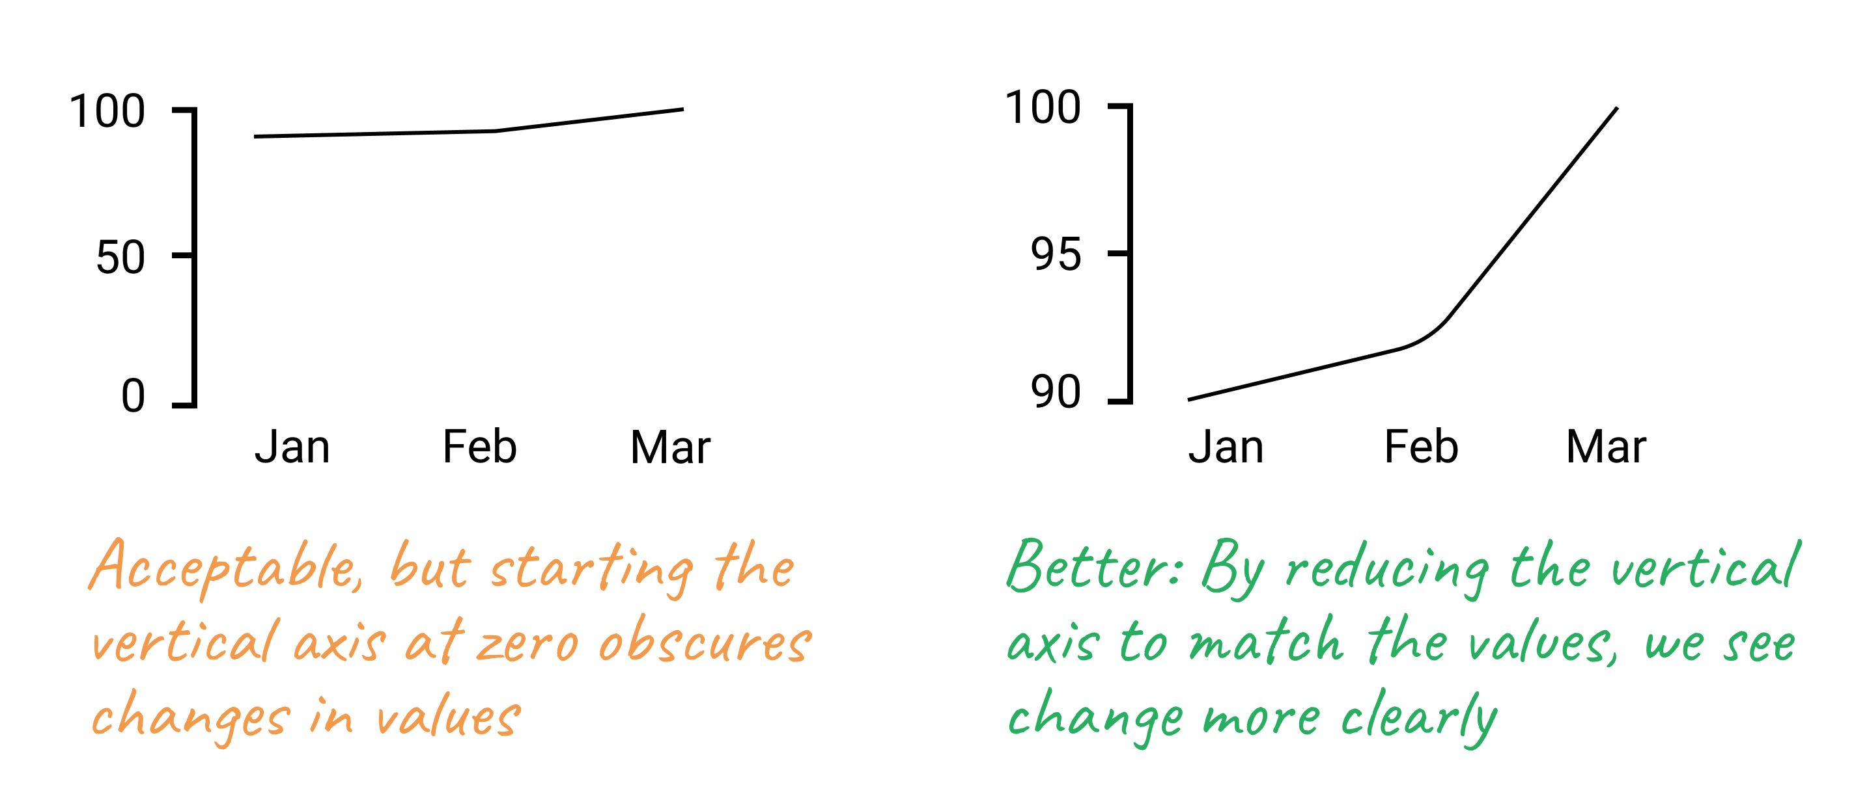
Daily sins of (academic) data visualization: But the zero-baseline rule does not apply to line charts.
Source: “Hands-On Data Visualization” by Jack Dougherty & Ilya Ilyankou

Slide 13
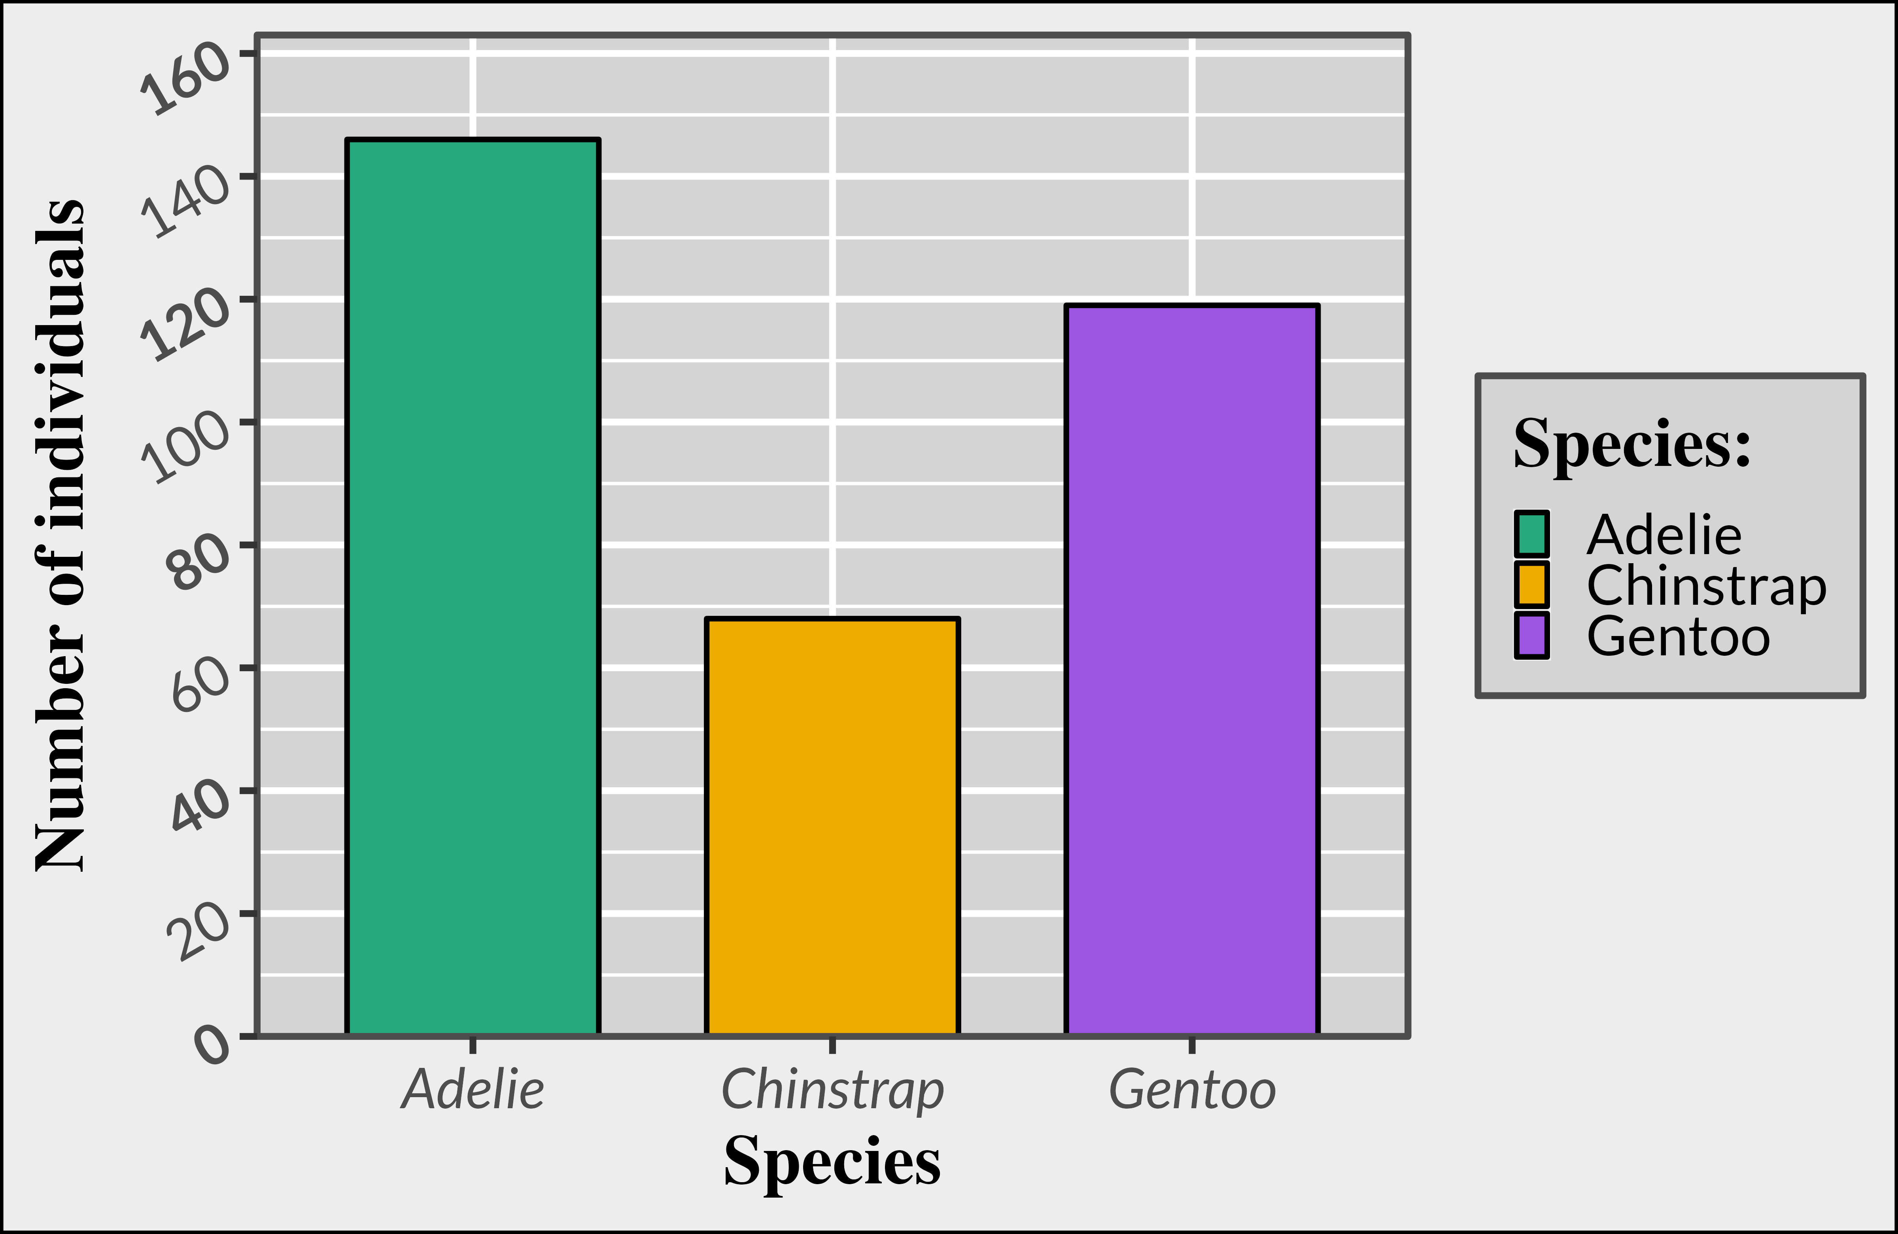
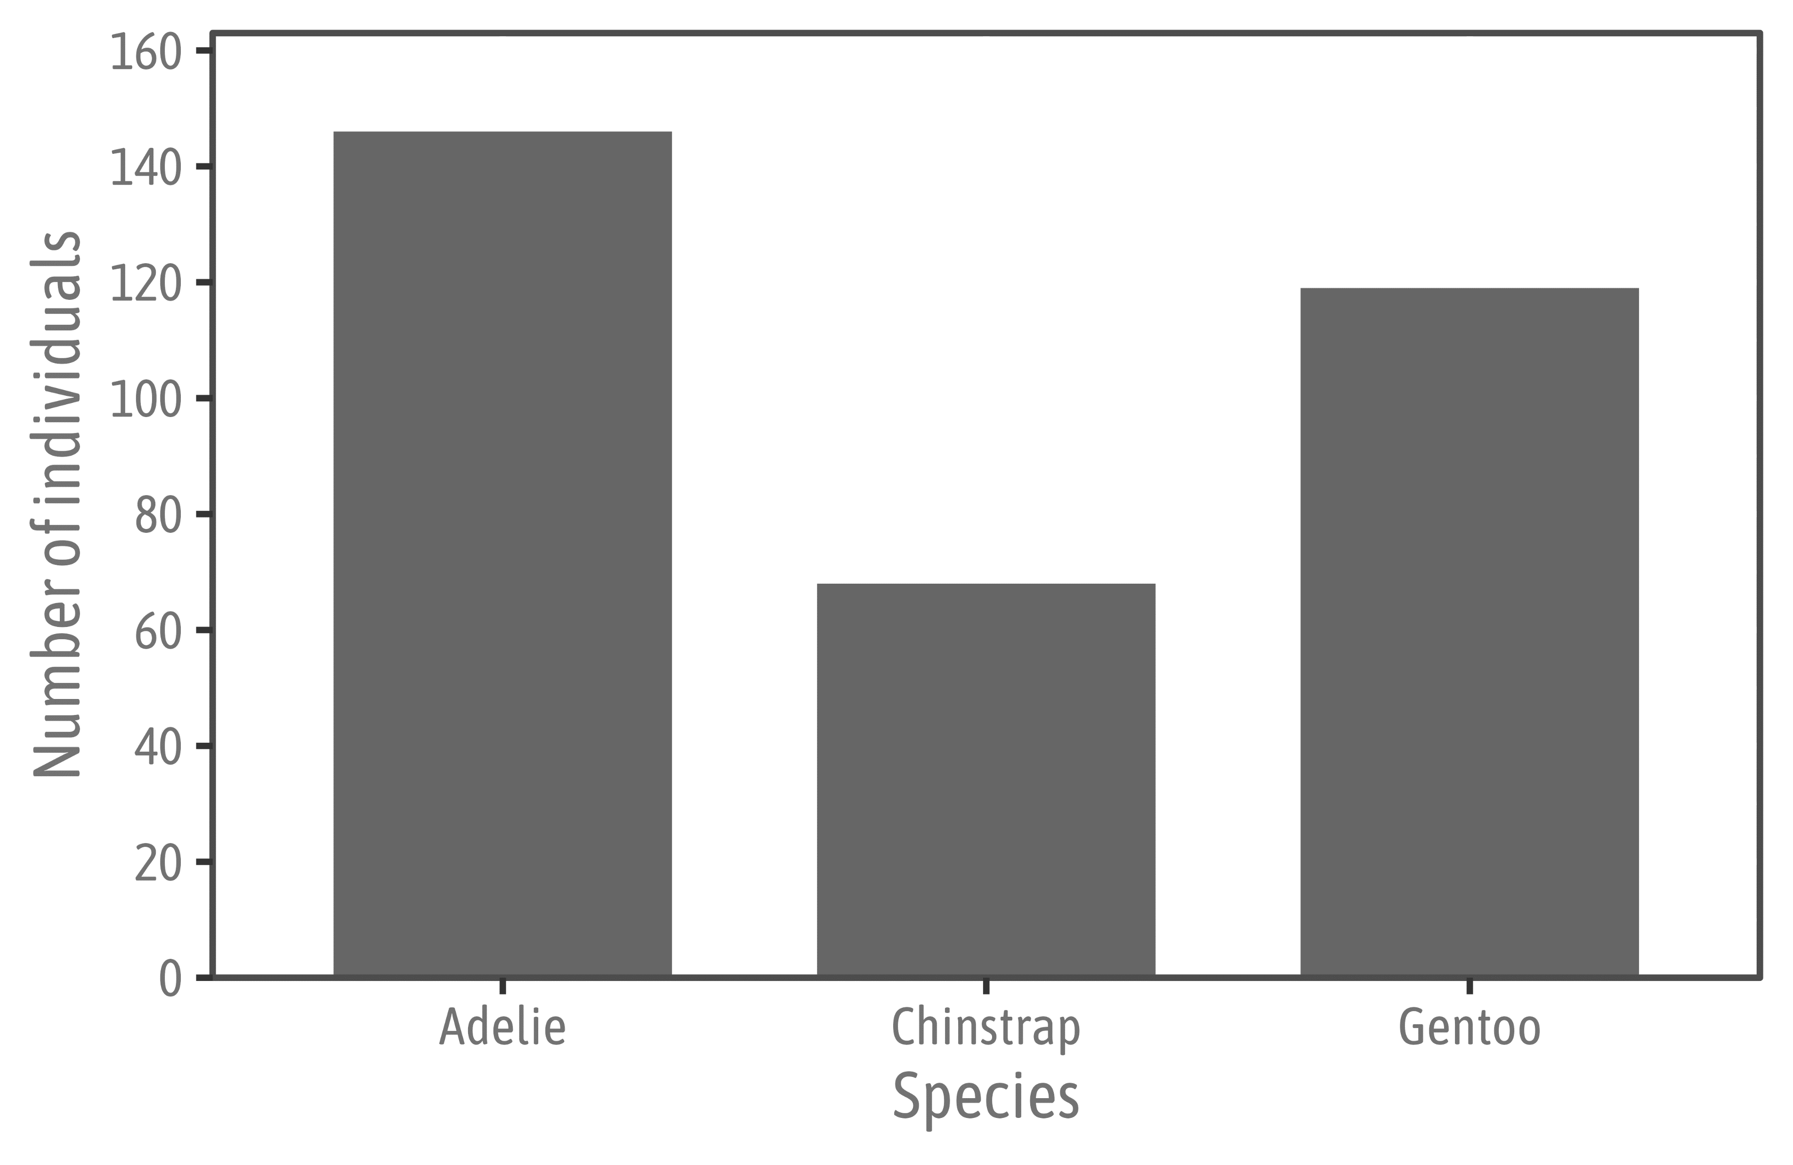


Daily sins of (academic) data visualization: DECLUTTER
Source: Cédric Scherer // posit::conf(2023)

Slide 14
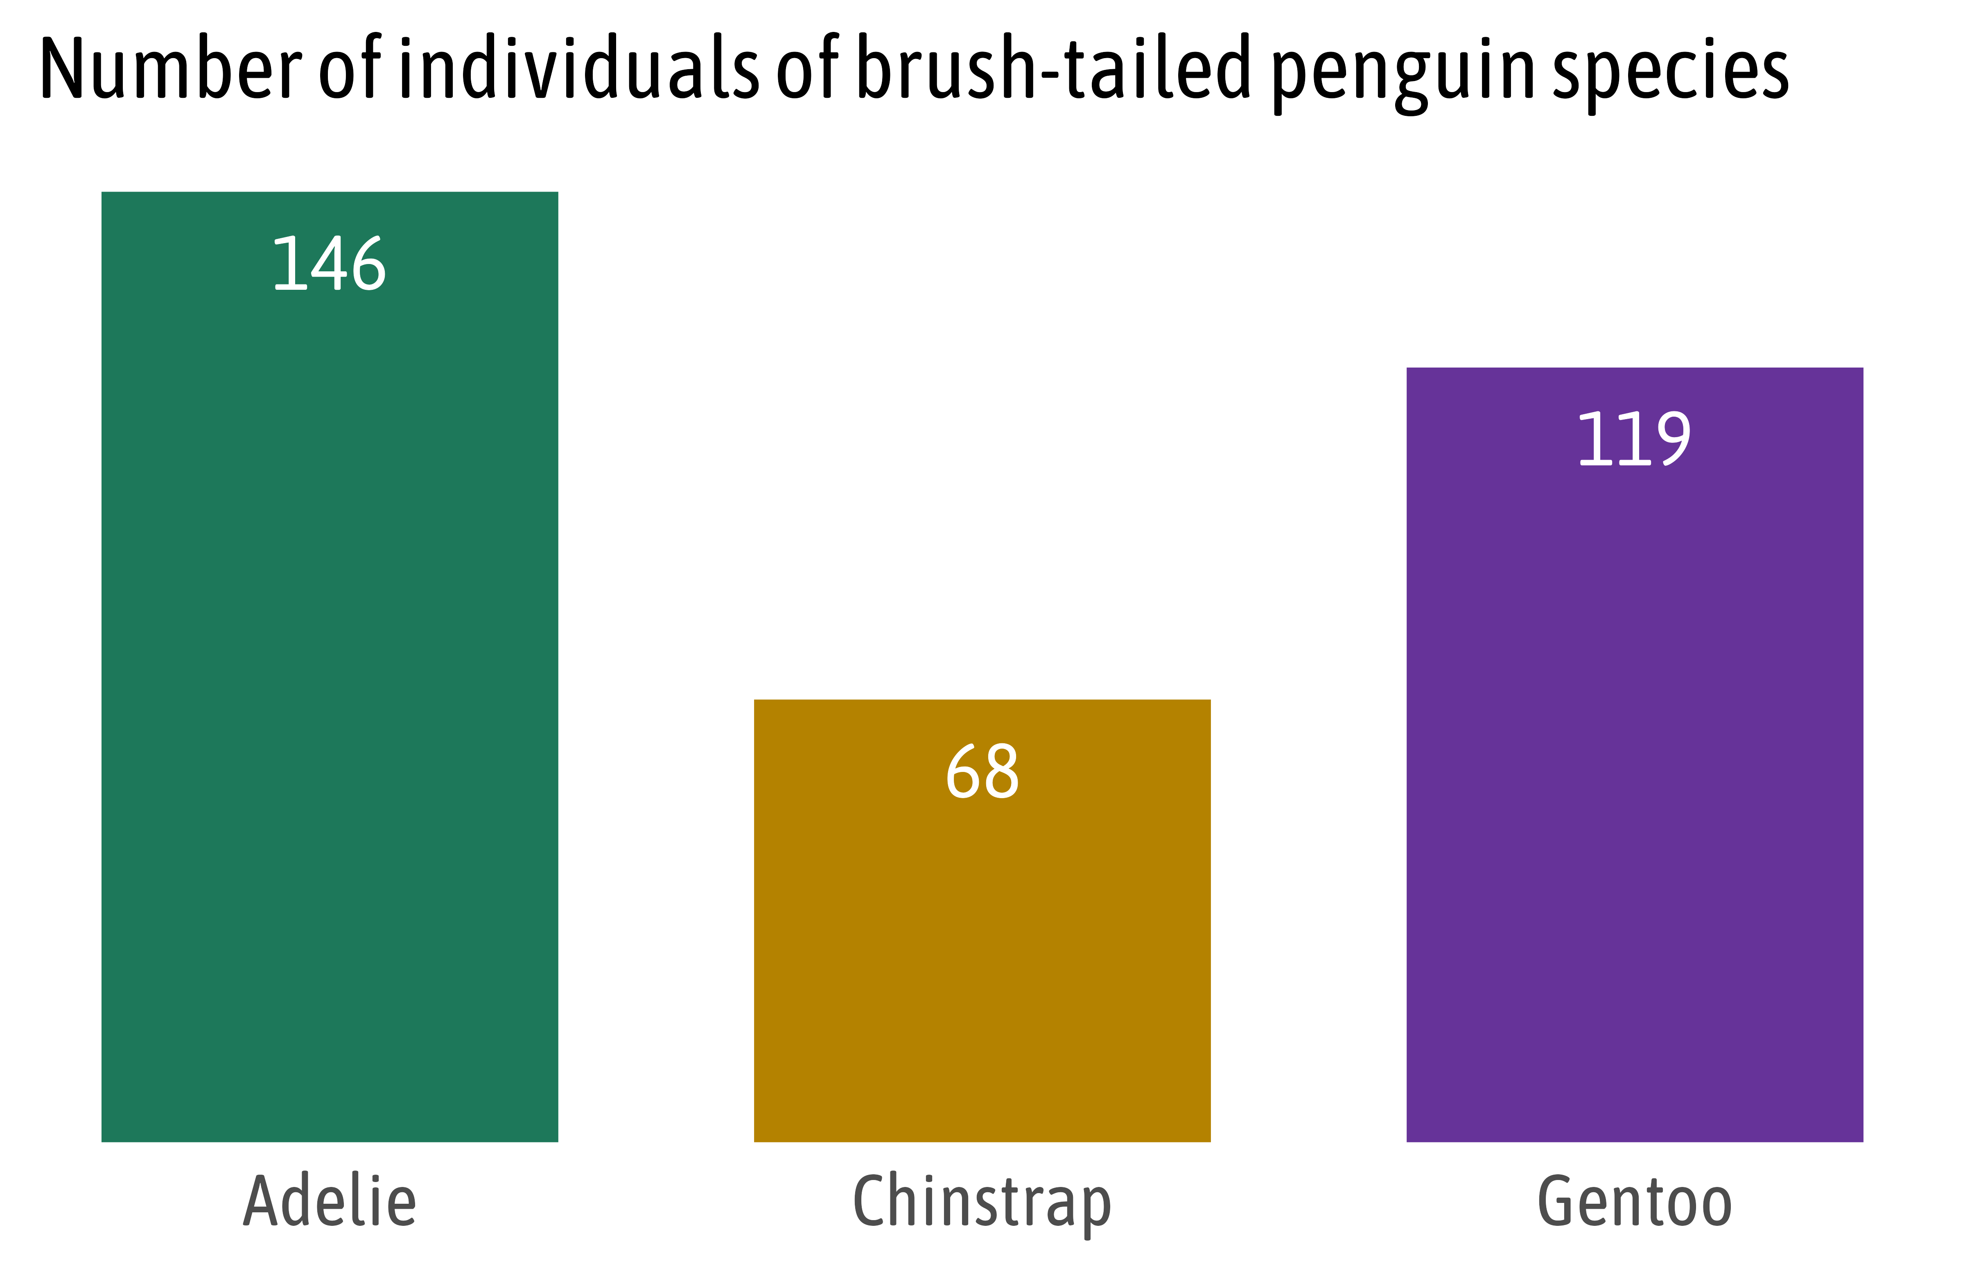
Daily sins of (academic) data visualization: DECLUTTER
Source: Cédric Scherer // posit::conf(2023)

Slide 15
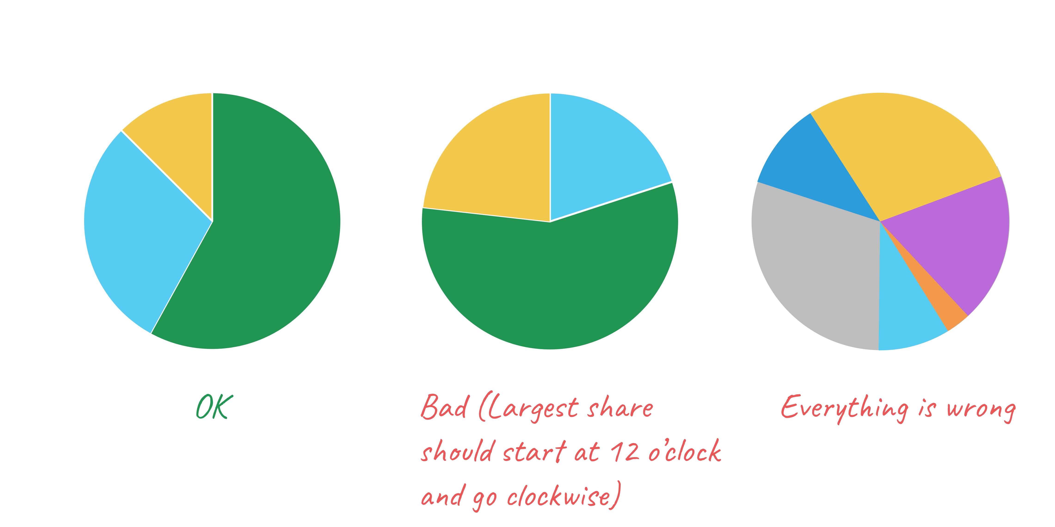
Daily sins of (academic) data visualization: BE AWARE WITH PIE CHARTS
Source: “Hands-On Data Visualization” by Jack Dougherty & Ilya Ilyankou

Slide 16
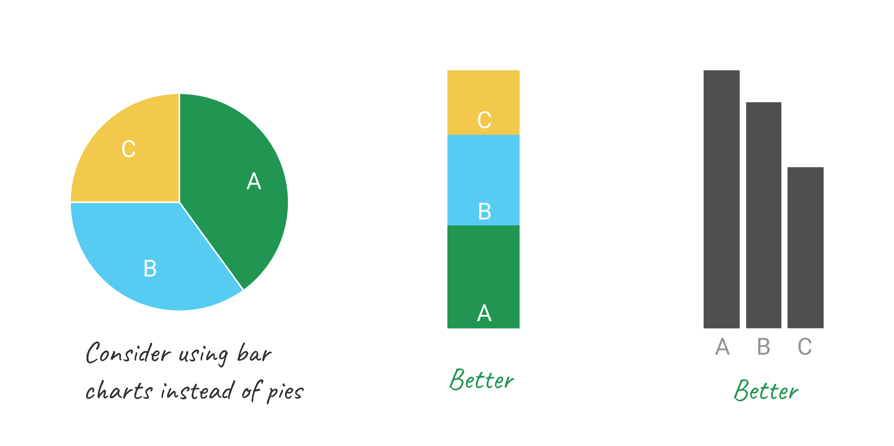
Daily sins of (academic) data visualization: BE AWARE WITH PIE CHARTS
Source: “Hands-On Data Visualization” by Jack Dougherty & Ilya Ilyankou

Slide 17
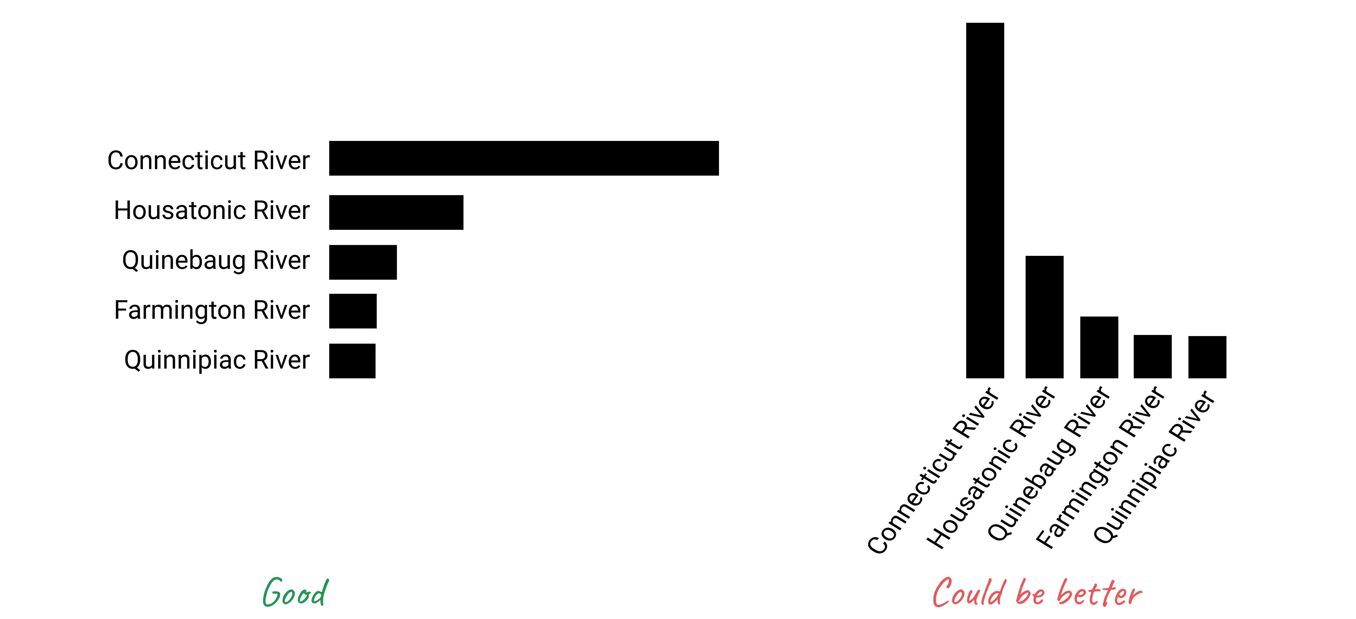
Daily sins of (academic) data visualization: FLIP YOUR AXIS
Source: “Hands-On Data Visualization” by Jack Dougherty & Ilya Ilyankou

Slide 18
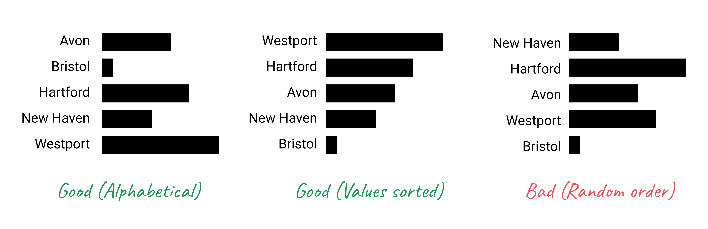
Daily sins of (academic) data visualization: ARRANGE ELEMENTS ON THE Y-AXIS
Source: “Hands-On Data Visualization” by Jack Dougherty & Ilya Ilyankou

